Slide 1

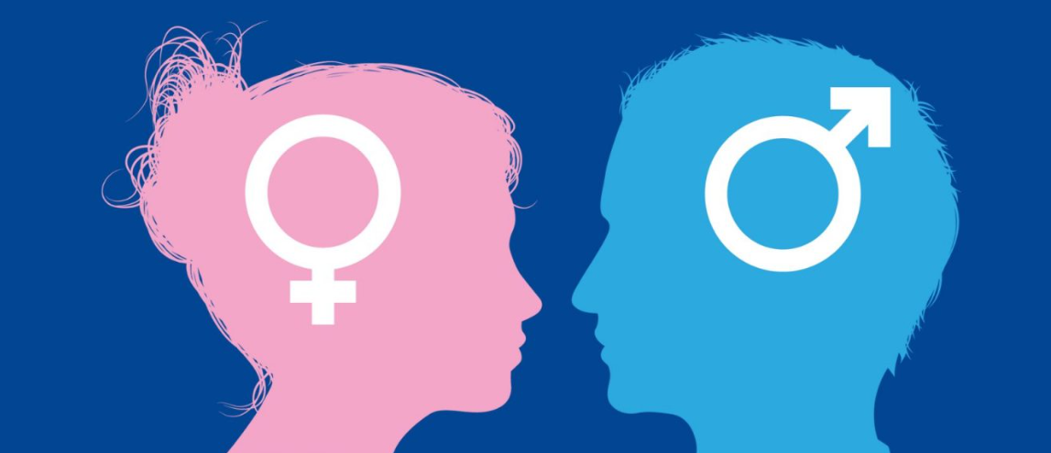
IMPACT OF COVID-19 VACCINES ON MALE AND FEMALE FERTILITY: A SCOPING REVIEW
Student Name | Student Id | Other Info
Acknowledgement
Methods
Type here
Scoping review conducted using JBI and PRISMA-ScR guidelines.
Comprehensive search: PubMed, MEDLINE, Google Scholar (Dec 2020–Apr 2025).
Included 41 studies: cohort, cross-sectional, case-control, systematic reviews, meta-analyses.
Quality assessment: Newcastle-Ottawa Scale (NOS) and ROBIS.
Focused on individuals of reproductive age, covering all major vaccine platforms.
Results
Abstract
Identification of studies via databases and registers
Social media myths fuelled concerns about COVID-19 vaccines and fertility (Lee et al., 2022).
Purpose: To assess whether COVID-19 and COVID-19 vaccination impact male and female fertility, focusing on potential effects on reproductive outcomes.
Methods: Conducted a scoping review of 41 peer-reviewed studies, including observational studies and systematic reviews, analyzing fertility markers, menstrual patterns, hormonal changes, and semen parameters.
Results: No long-term adverse effects on fertility or reproductive health from COVID-19 vaccines in either sex; any observed menstrual or sperm changes were mild and temporary.
Disruptions in fertility were more often linked to infection-induced inflammation, pandemic-related stress, or underlying health conditions than to vaccination.
Conclusion: COVID-19 vaccines are safe for reproductive-age individuals, with no evidence of harm to fertility, supporting continued vaccination and public reassurance.
No evidence of long-term adverse effects on male or female fertility from any COVID-19 vaccine.
Transient menstrual changes (cycle length or flow) observed in some females; all resolved within 1–3 months.
No link between vaccination and increased risk of miscarriage, reduced ovarian reserve, or hormonal disruption.
Temporary reduction in sperm motility in some males; resolved quickly with no long-term effect.
Most reported reproductive disruptions were associated with pandemic-related stress, not vaccination.
Findings were consistent across mRNA, viral vector, and inactivated vaccines.
Records identified via MEDLINE search (n = 317)
Additional records identified via PubMed search (n = 58)
Google Scholar records screened (n = 50)
Identification
Records Screened- title and abstract (n = 317)
Duplicates excluded from PubMed (n = 31)
Articles excluded - irrelevant or opinion-based (n = 50)
Records excluded as irrelevant after screening (n = 267)
Remaining PubMed articles screened (n = 27)
Screening
Articles excluded did not meet the inclusion criteria (n = 27)
Full-text articles assessed for eligibility (n = 50)
Full text articles excluded (n=9)
Participants outside the age range
Introduction
Included
Studies included in scoping review (n = 41)
PRISMA flow chart for the included studies
Background Information:
Social media myths fuelled concerns about COVID-19 vaccines and fertility (Lee et al., 2022).
Public hesitancy influenced by anecdotal reports, misinformation, and misinterpreted science.
Concerns focused on possible menstrual changes, fertility problems, and reproductive harm (Ittefaq et al., 2024).
Urgent need to clarify real risks vs. myths with scientific evidence.
Objective:
The core aim of this scoping review is to assess the impact of COVID-19 vaccines on male and female fertility.
Research Question:
This scoping review addresses the following primary research question:
What is the impact of COVID-19 vaccines on male and female fertility parameters?
Discussion
Interpretation: The results confirm that COVID-19 vaccines do not cause long-term harm to male or female fertility, helping to address widespread public concerns.
Comparison: Findings align with previous research, which also found no significant negative impact of COVID-19 vaccination on reproductive health outcomes.
Limitations: The study relied on self-reported data, had limited representation of male fertility studies, and did not include non-English publications, which may affect generalizability.
Conclusion
Aims
COVID-19 vaccines are safe for reproductive health in both men and women.
Addressing misinformation is key to increasing vaccine confidence.
Ongoing monitoring and research on new vaccines and booster doses remain important.
Clear, evidence-based public health communication should be prioritized.
To systematically map current evidence on COVID-19 vaccine effects on:
Female and male fertility
Menstrual patterns
Hormonal changes
Reproductive outcomes (e.g., miscarriage)
b) To provide clear answers to counteract misinformation and guide public health.
References
Ajana, B., Engstler, E., Ismail, A. & Kousta, M. 2022. Perceptions and attitudes towards Covid-19 vaccines: Narratives from members of the UK public. Journal of Public Health, 31, 1699-1715.
Amir , K. (2021, 2 15). Is it safe for pregnant women to have a COVID-19 vaccine? Retrieved from Aljazeera: https://www.aljazeera.com/features/2021/2/15/coronavirus-vaccines-pregnancy-breastfeeding-and-fertility
Ittefaq, M., Vu, H. T., Zain, A., Ramazan, T. & Kreps, G. L. 2024. Analysis of public opinion polls about COVID-19 vaccines: Theoretical and policy implications for vaccine communication and campaigns to address vaccine hesitancy. Human Vaccines & Immunotherapeutics, 20.
Lee, S.K., Sun, J., Jang, S. et al. Misinformation of COVID-19 vaccines and vaccine hesitancy. Sci Rep 12, 13681 (2022). https://doi.org/10.1038/s41598-022-17430-6.
Sally , R. (2020, 11 22). COVID-19 potentially has negative impacts on male fertility. Retrieved from https://www.news-medical.net/news/20201122/COVID-19-potentially-has-negative-impacts-on-male-fertility.aspx
Shook, L. L., Fallah, P. N., Silberman, J. N., & Edlow, A. G. (2021). COVID-19 vaccination in pregnancy and lactation: current research and gaps in understanding. Frontiers in cellular and infection microbiology, 11, 735394.
Wang, S., Wang, N., Yao, G., Su, Y., & Qi, L. (2024). The type of COVID− 19 vaccination does not affect reproductive function and pregnancy outcomes in infertile couples. Frontiers in Endocrinology, 15, 1356938.
Source: Sally (2020)

